Slide 1
Chapter 20 – Product and Process Design: Scalable and Sustainable Tissue Engineered Product Manufacturing

Slide 2
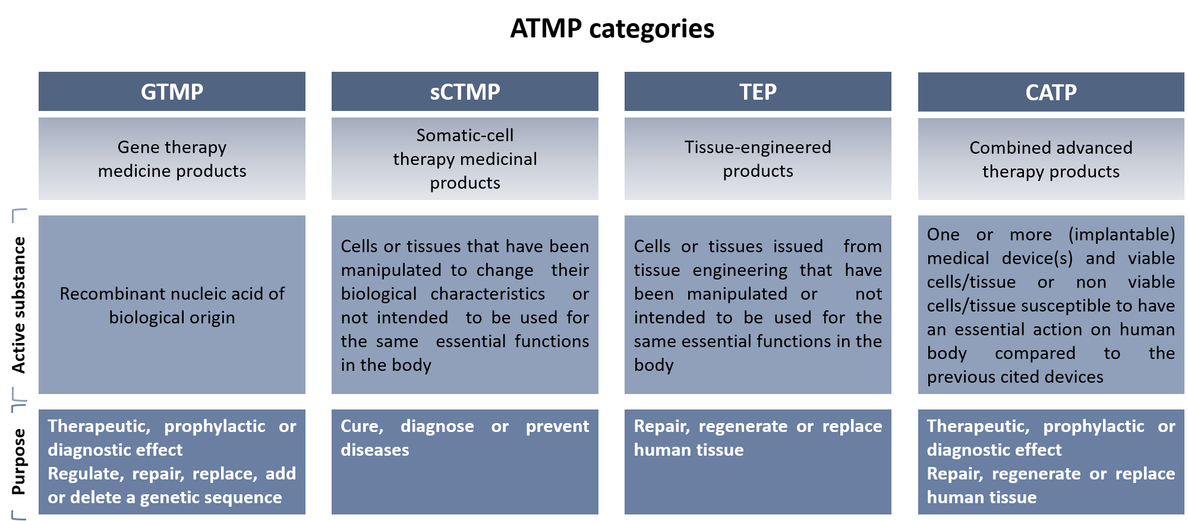
Notes:
Figure 20.1 : ATMP classification (EU, EMA – CAT).

Slide 3
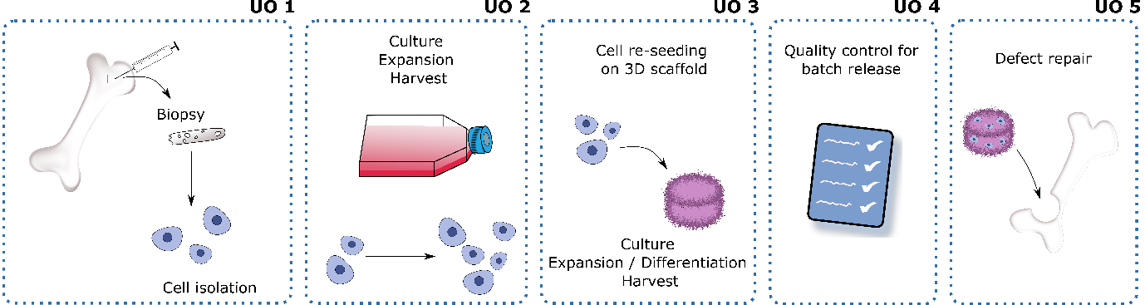
Notes:
Figure 20.2: General manufacturing process of a bone derived TE product.

Slide 4
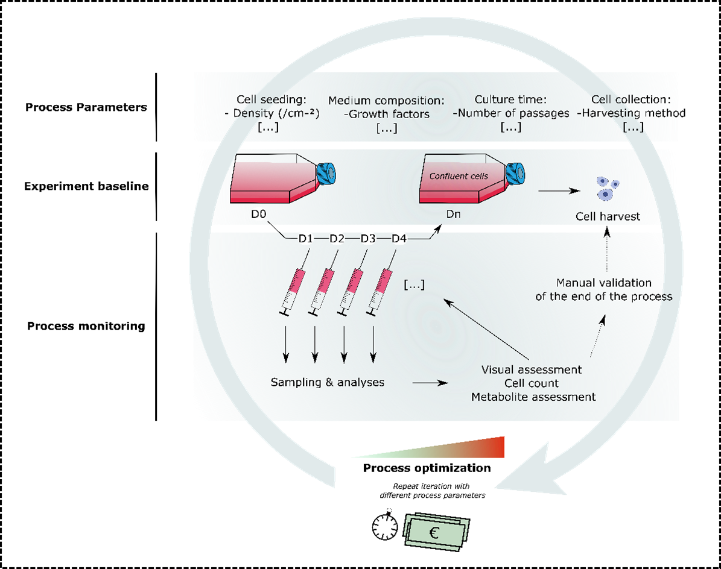
Notes:
Figure 20.3: Detailed Unit Operation 2.

Slide 5
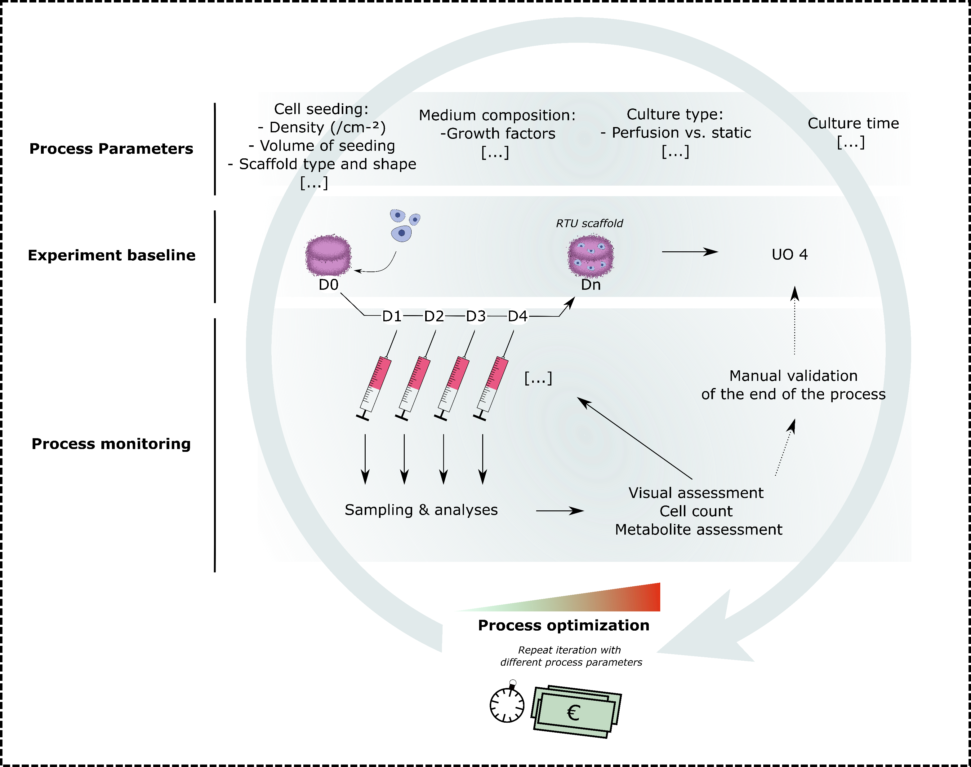
Notes:
Figure 20.4: Detailed Unit Operation 3.

Slide 6
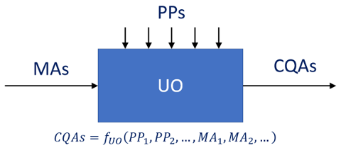
Notes:
Figure 20.5: Illustration of the concept of a Unit Operation.

Slide 7
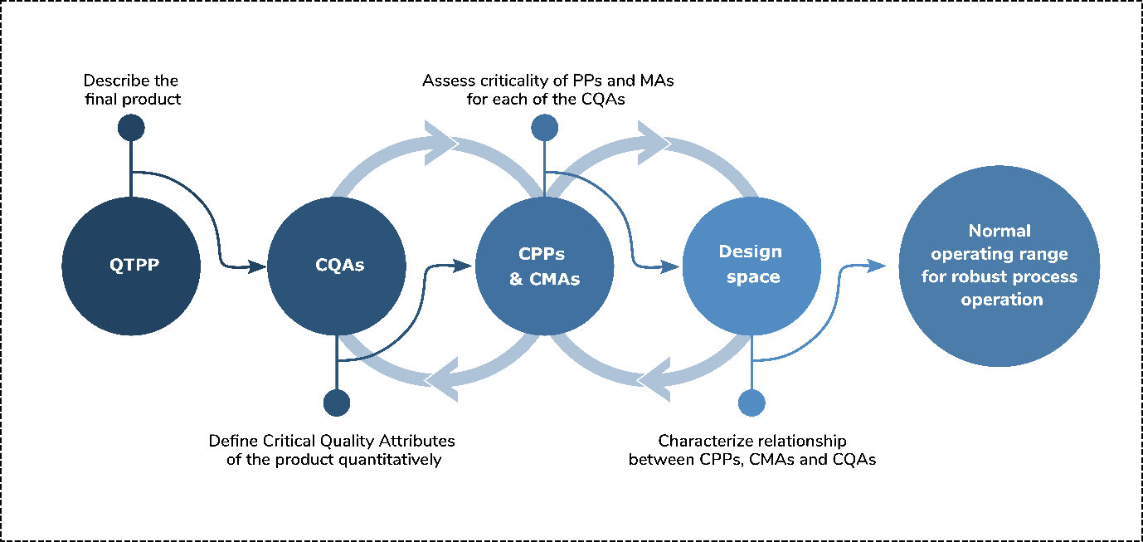
Notes:
Figure 20.6: Quality by Design workflow.

Slide 8
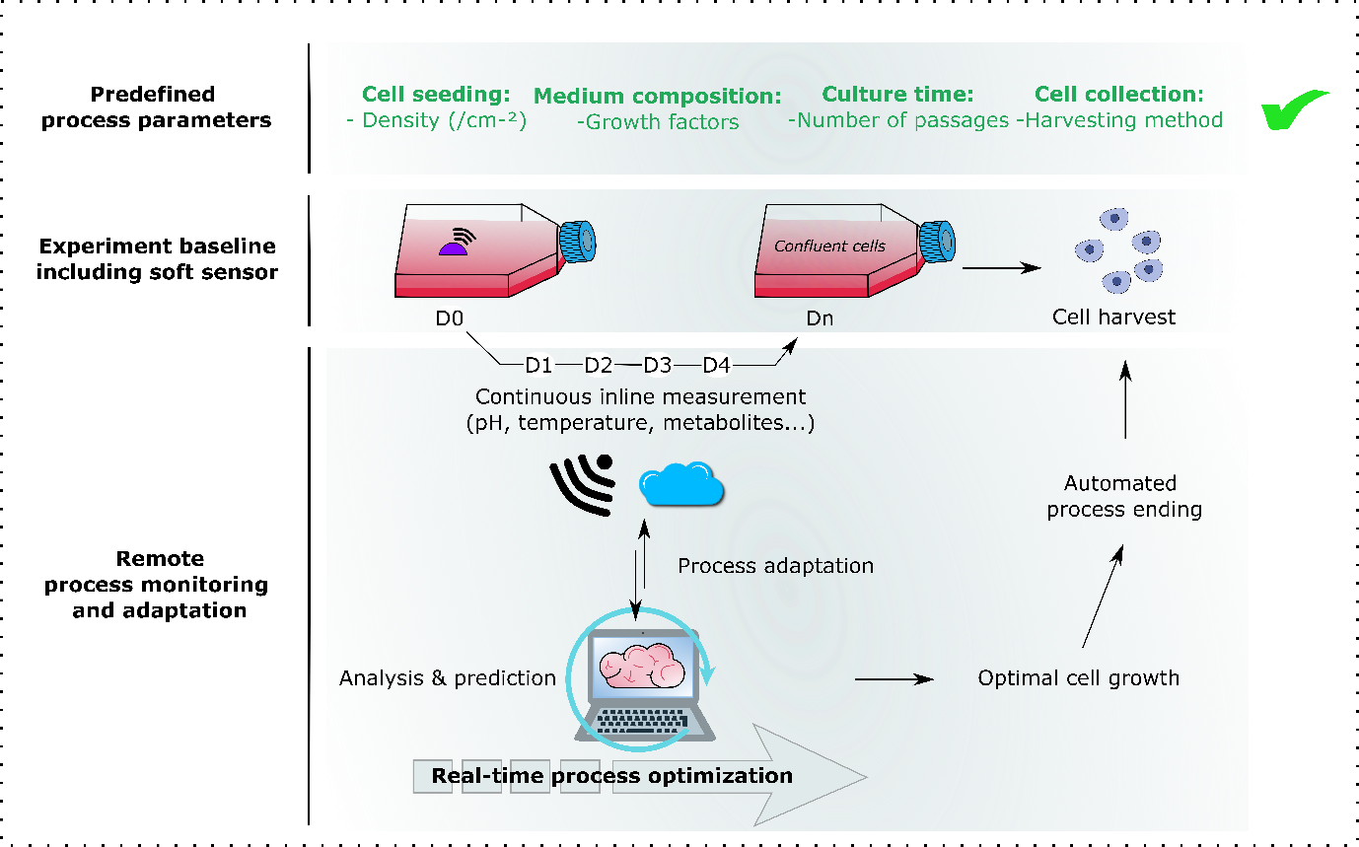
Notes:
Figure 20.7: Role of soft sensors in process monitoring.

Slide 9
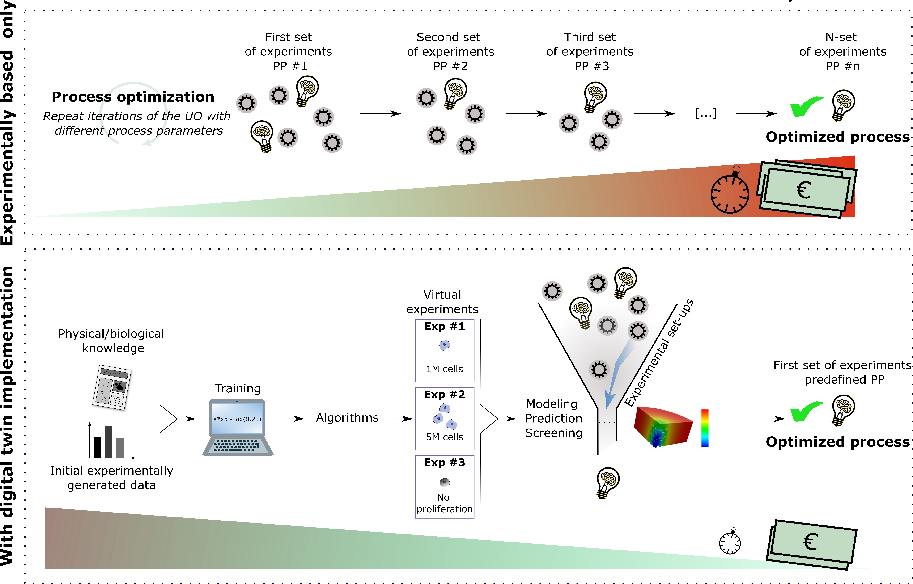
Notes:
Figure 20.8: Process optimization with or without digital twin implementation.

Slide 10
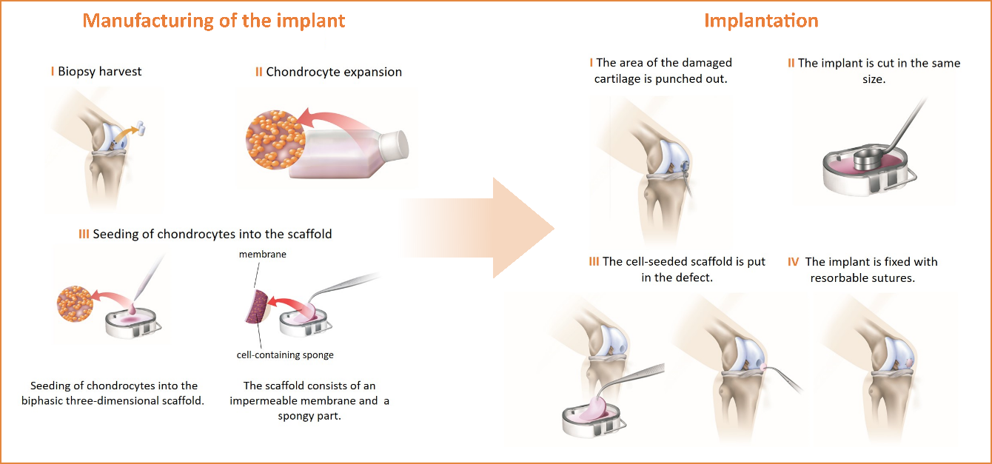
Notes:
Figure 20.9: An illustration of the manufacturing process of Novocart® 3D.
Adapted from NOVOCART® 3D, 2021, https://www.aesculapbiologics.com/en/patients/novocart-3d.html.

Slide 11
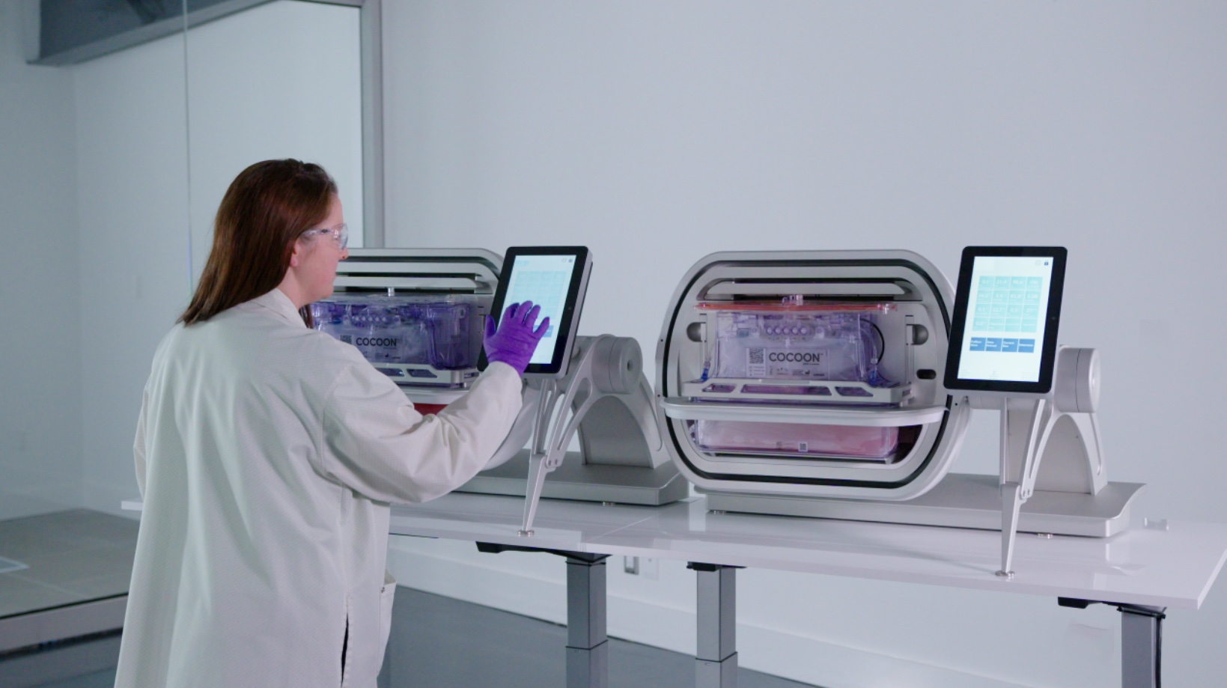
Notes:
Figure 20.10: A visualization of the Lonza/OCTANE Cocoon system.
From Octane Medical Group Inc..

